Slide 1
Introduction to Attention Mechanisms in AI
From RNNs to Transformers

Slide 2

Introduction to Attention Mechanisms
Originated as a solution to capture long-range dependencies in sequence modeling
Inspired by human cognitive attention — focusing on relevant parts of input
Key advantage: Allows models to dynamically weigh importance of different sequence elements
First applied in Neural Machine Translation (NMT) to improve encoder-decoder architectures (Vaswani et al., 2017)

Slide 3
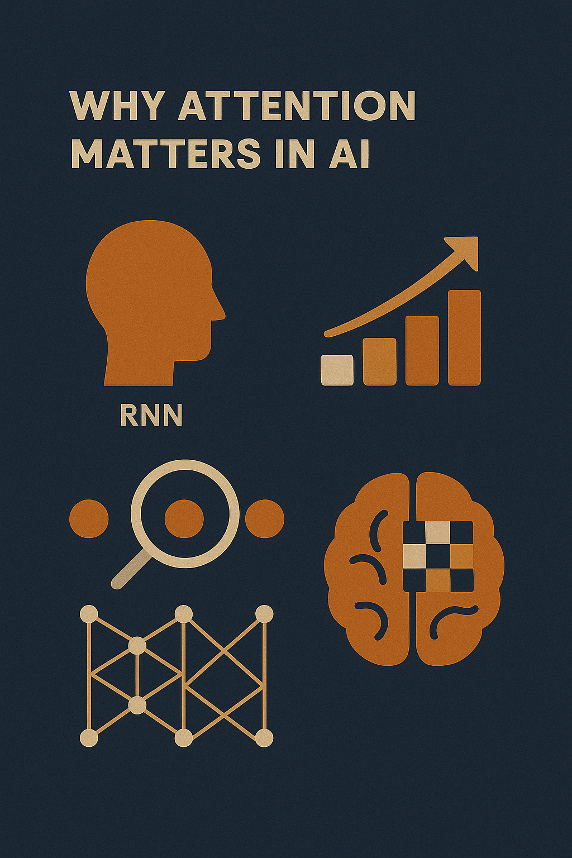
Why Attention Matters in AI
Traditional RNNs process sequentially — limiting parallelism
Difficulty learning long-range dependencies due to vanishing gradients
Attention enables:
Direct connections between any two positions in sequence
Parallel computation across positions
Revolutionized natural language processing, vision, and multimodal AI (Vaswani et al., 2017)

Slide 4
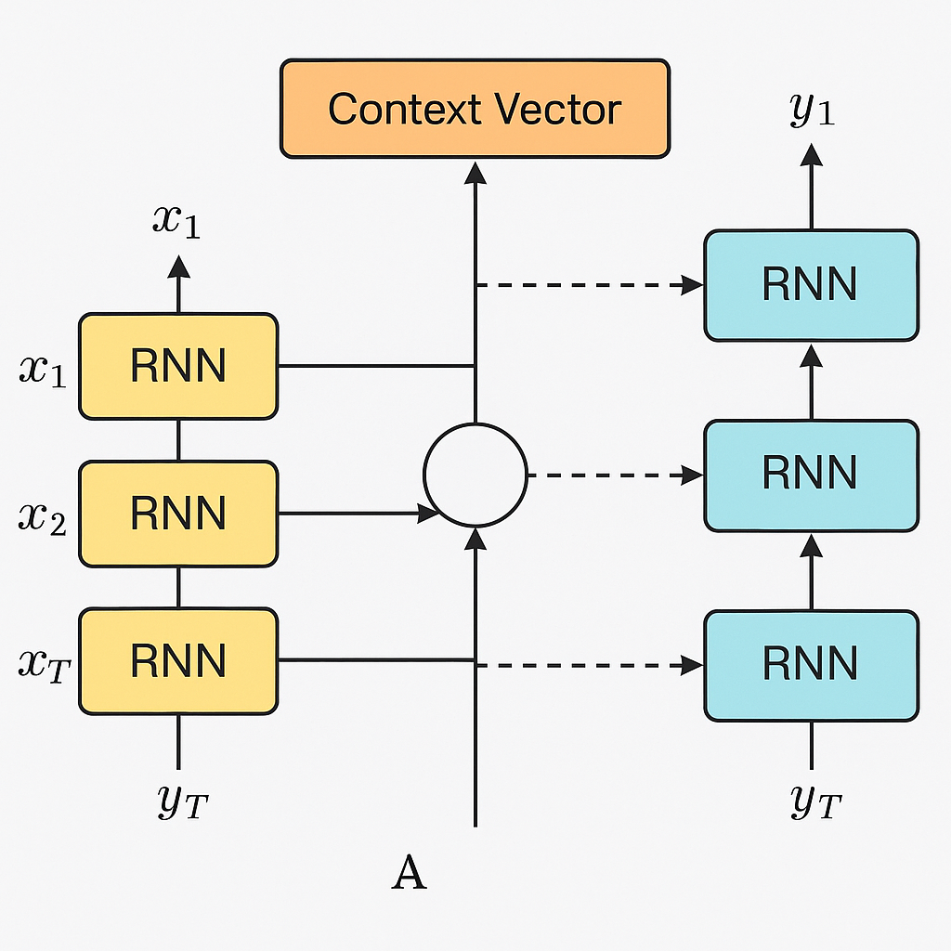
Attention in RNN Models
Classic setup: Encoder–decoder with RNNs (LSTM/GRU)
Attention computes a context vector at each decoding step based on encoder outputs
The context vector is a weighted sum of the encoder’s hidden states, where the weights are attention scores indicating the relevance of each encoder output to the current decoding step.
Improves translation by focusing on relevant source words for each output word
Eliminates bottleneck of a single fixed-length context vector (Vaswani et al., 2017)

Slide 5
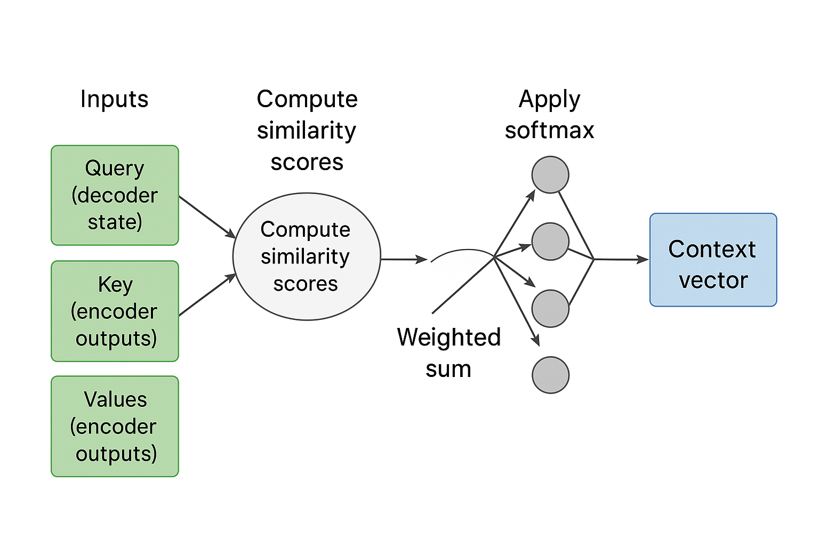
How Attention Works in RNNs
Inputs: Query (decoder state), Keys (encoder outputs), Values (encoder outputs)
Compute similarity scores between query and keys
Apply softmax to get attention weights
Weighted sum of values → context vector for next prediction step
Allows adaptive focus on different parts of input per time step

Slide 6
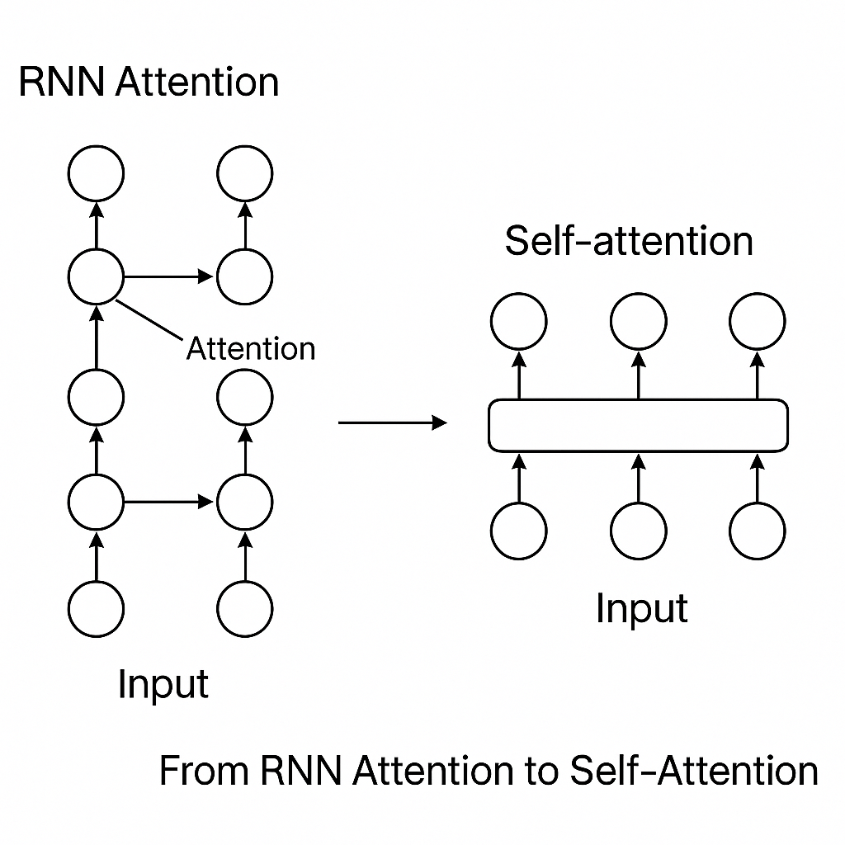
From RNN Attention to Self-Attention
RNN attention still limited by sequential computation
Self-attention replaces recurrence with direct interactions between tokens
In attention, any token can directly access information from any other token in a single step, eliminating the need to pass information through multiple intermediate positions and thus reducing the maximum dependency path length from 𝑂(𝑛) to 𝑂(1).
Forms the foundation of the Transformer (Vaswani et al., 2017)

Slide 7
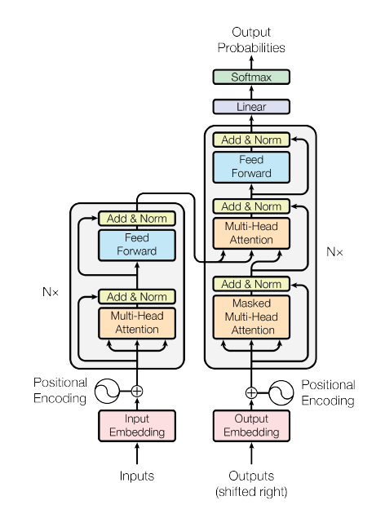
Transformer Overview
Introduced in Attention is All You Need (Vaswani et al., 2017)
Fully attention-based — no recurrence, no convolution
Encoder–decoder architecture with multi-head self-attention and feed-forward layers
Benefits:
Highly parallelizable
Captures global dependencies efficiently
Achieves state-of-the-art results in translation and beyond
(Vaswani et al., 2017)

Slide 8
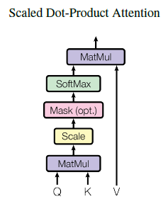
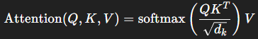
Scaled Dot-Product Attention
Core formula:
Scaling prevents large dot products from saturating softmax
Computationally efficient using matrix multiplications
Forms the basis of multi-head attention (Vaswani et al., 2017)
(Vaswani et al., 2017)

Slide 9
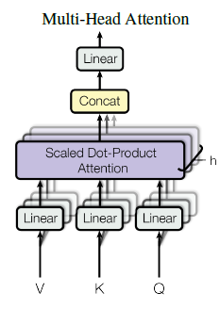
Multi-Head Attention
Runs attention multiple times in parallel with different learned projections
Each head focuses on different relationships or positions
Outputs are concatenated and projected back to model dimension
Enables richer representation learning (Vaswani et al., 2017)
(Vaswani et al., 2017)

Slide 10
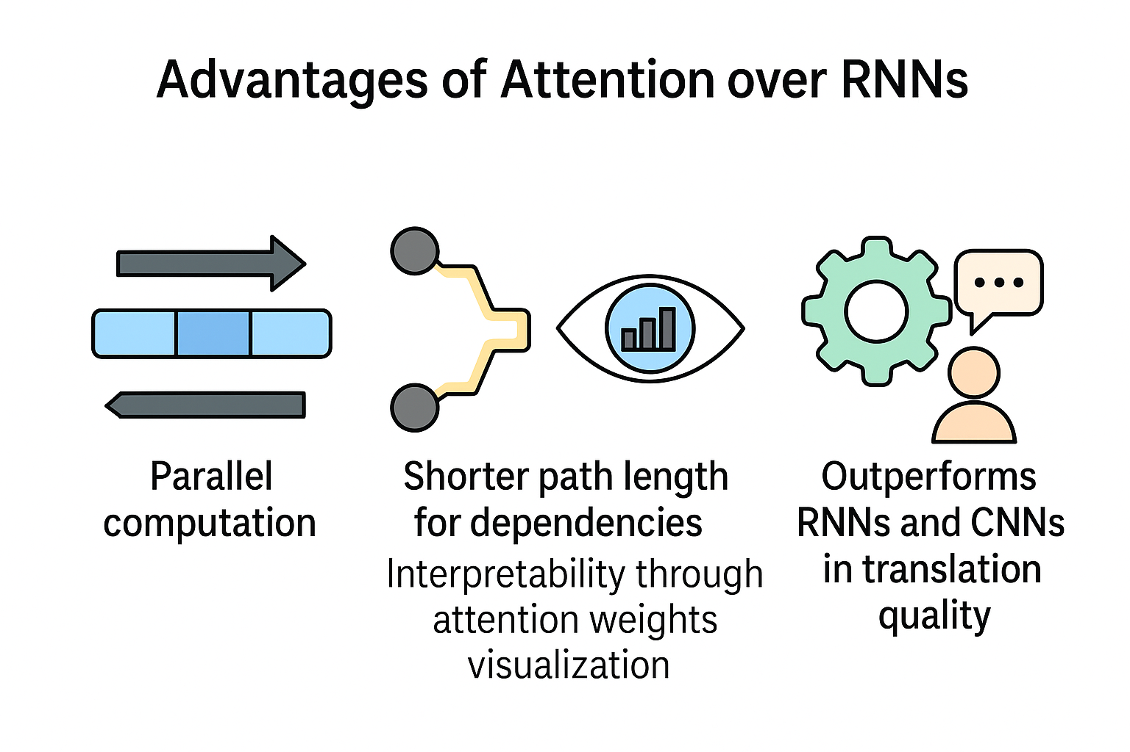
Advantages of Attention over RNNs
Parallel computation → faster training
Shorter path length for dependencies → better long-range modeling
Interpretability through attention weights visualization
Outperforms RNNs and CNNs in translation quality

Slide 11
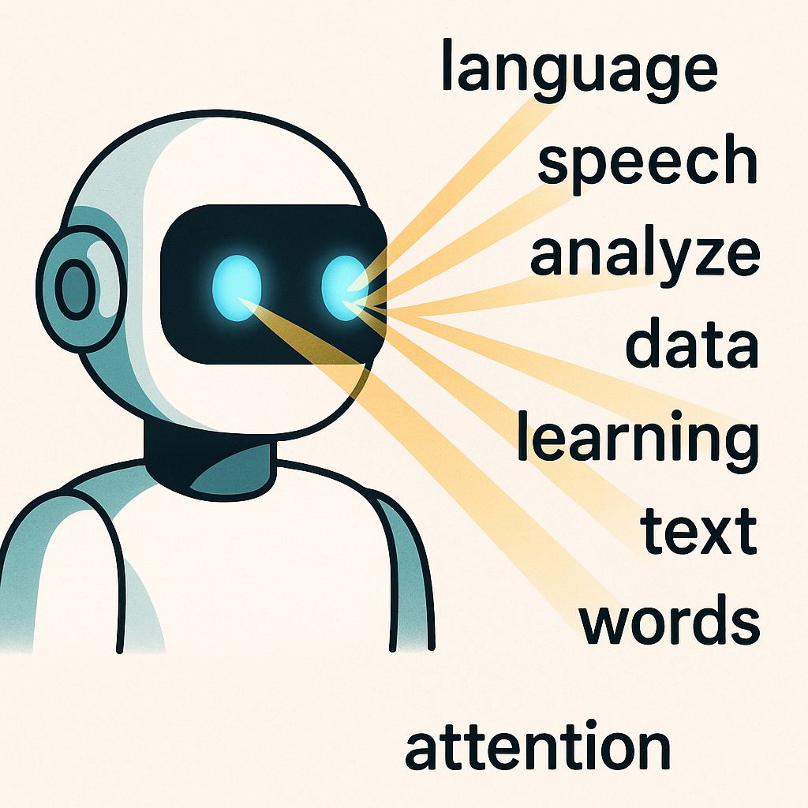
Conclusion
Attention mechanisms transformed sequence modeling
RNN attention improved translation, but Transformers revolutionized the field
Attention enables models to scale to longer sequences, larger datasets, and diverse modalities
Continues to inspire state-of-the-art architectures across AI disciplines (Vaswani et al., 2017)

Slide 12
THANK YOU
Reference
Vaswani, A., Shazeer, N., Parmar, N., Uszkoreit, J., Jones, L., Gomez, A. N., Kaiser, Ł., & Polosukhin, I. (2017). Attention is all you need. arXiv. https://arxiv.org/abs/1706.03762
Patrick Hill
phill86037@uat.edu
August 11, 2025
Note: Illustrations not already cited were created by ChatGPT 5

